Slide 1
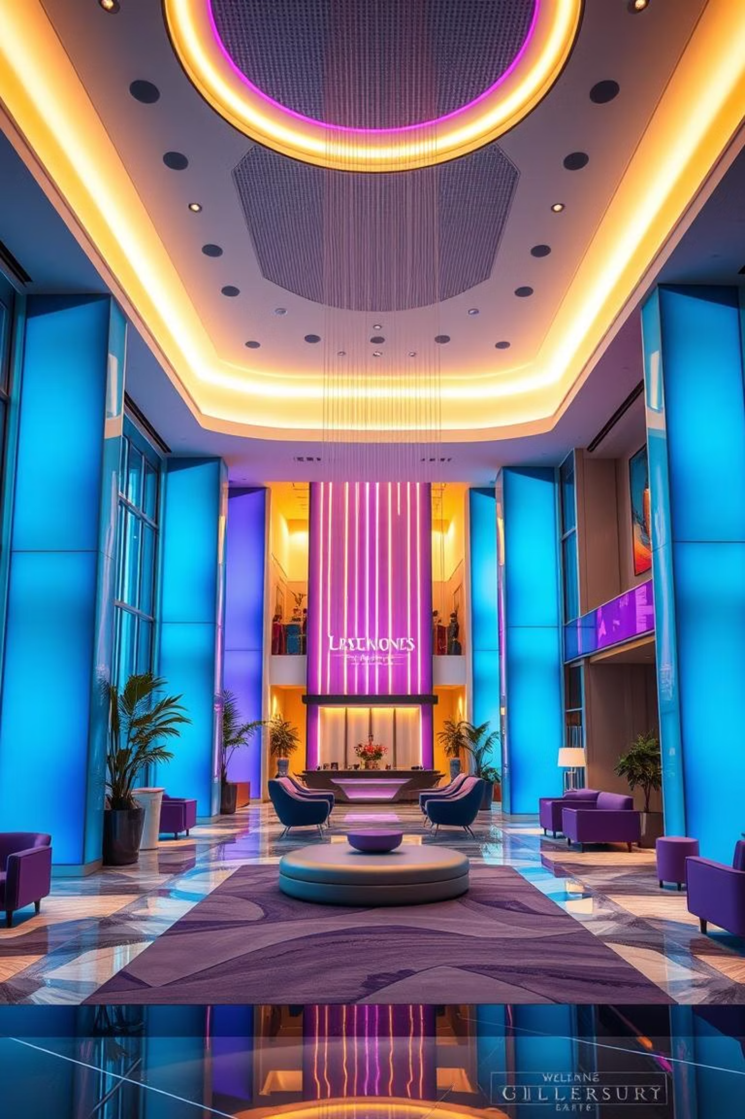
HOTEL DATA ANALYSIS: INSIGHTS FOR OPTIMIZATION
Unlocking Strategic Growth through Data-Driven Decisions
Presented by: S.A. HARI GANESH
NIIT DATA SCIENCE

Slide 2
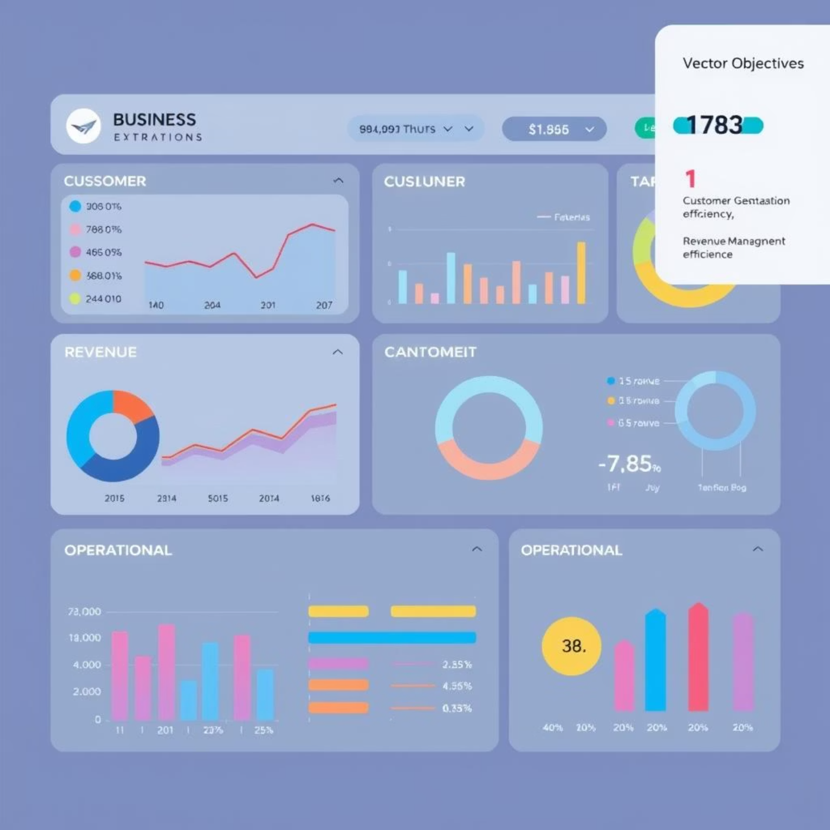

OBJECTIVES
Booking Pattern Analysis
Customer Segmentation
Revenue Management
Operational Efficiency
Loyalty Programs And repeat Business
Customer Satisfaction
Marketing and Sales Satisfaction

Slide 3
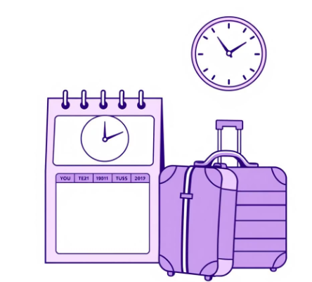
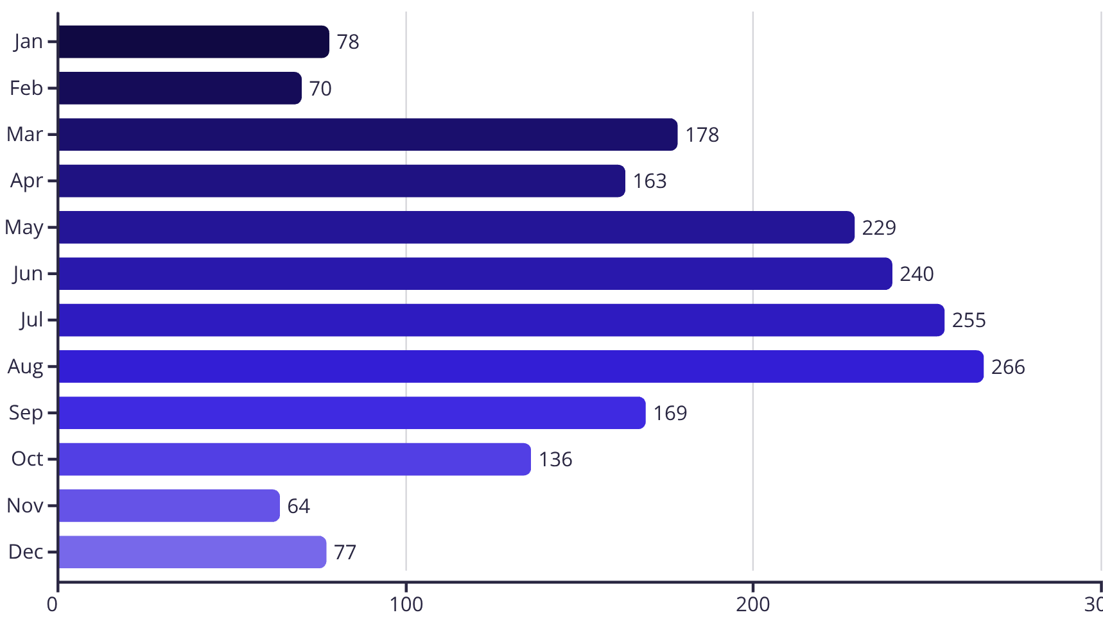
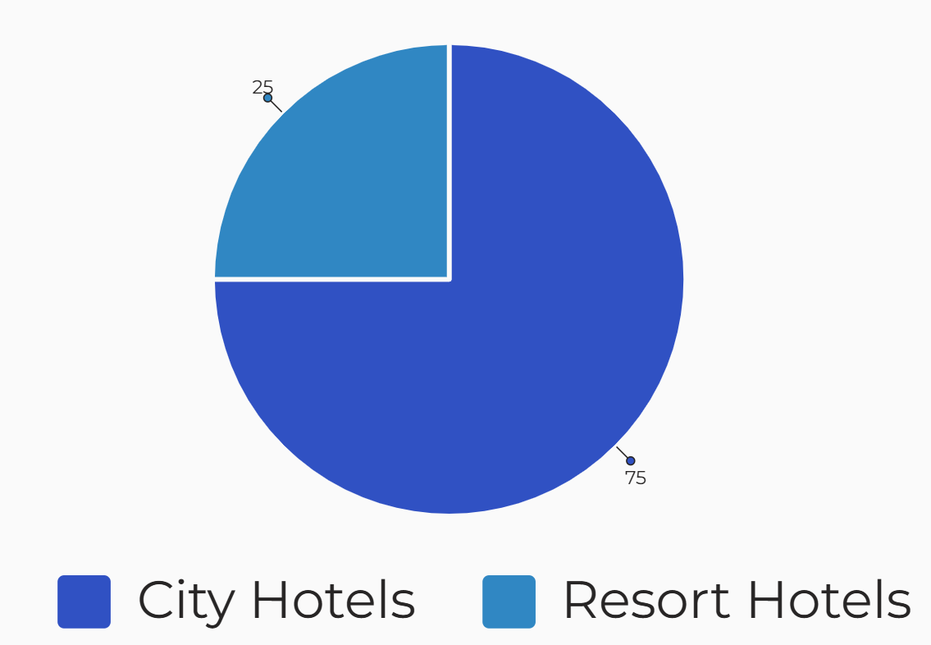
BOOKING PATTERN ANALYSIS
2097
Total Bookings
PEAK SEASON DOMINANCE
June-August has the high peak, with
36%(761) of bookings
Bookings by Month
November-February, 13.78% of
bookings indicate a 48% drop
OFF PEAK

Slide 4
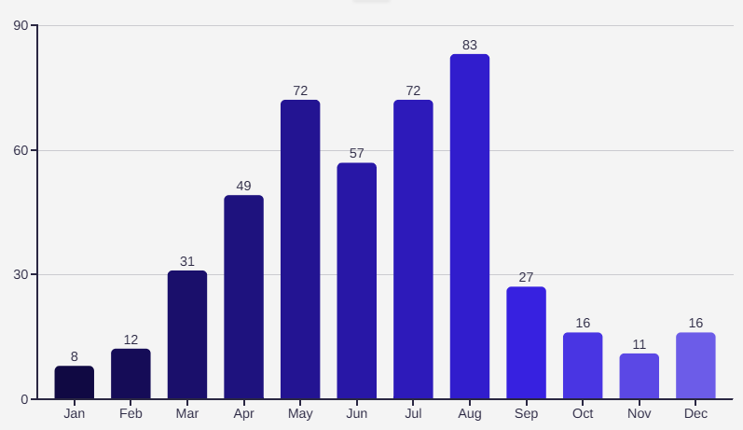
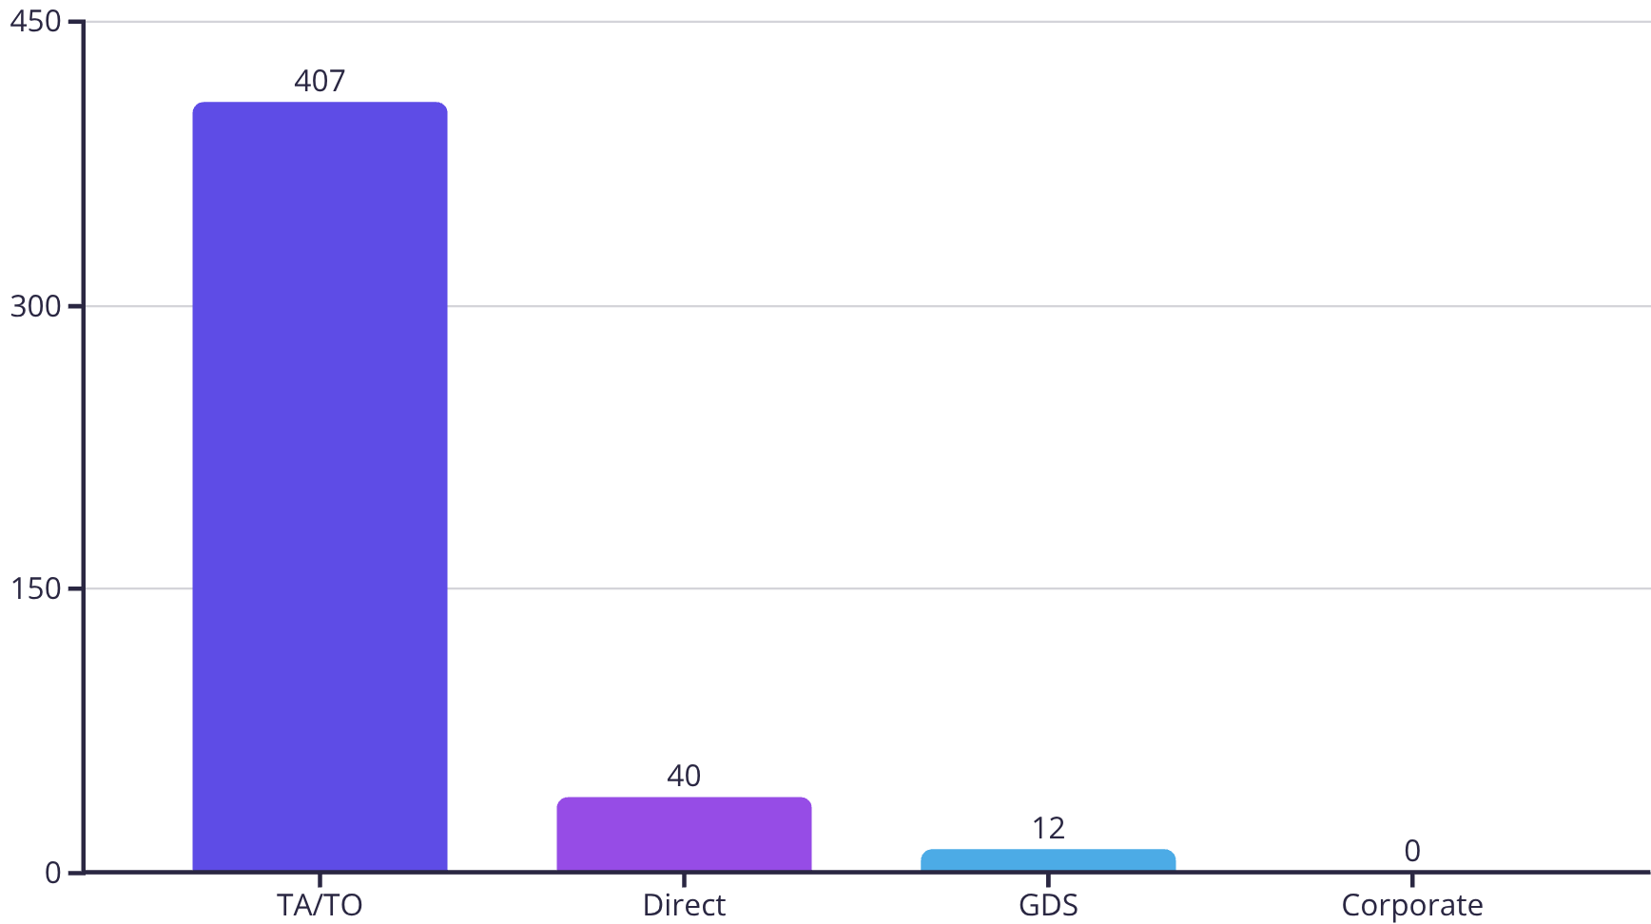
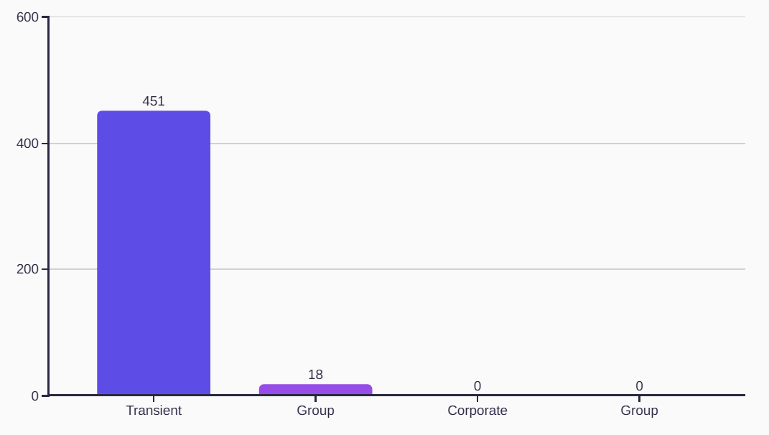





BOOKING CANCELLATIONS ANALYSIS
Cancellation Count By Month
Cancellation Count By Distribution Channel
Most cancellations come from TA/TO channels and transient customers.
Cancellations are highest during peak months (Jun – Aug)
Corporate bookings have zero cancellations
Group and GDS channels contribute very few cancellations.
Most Cancellation By Customer Type

Slide 5

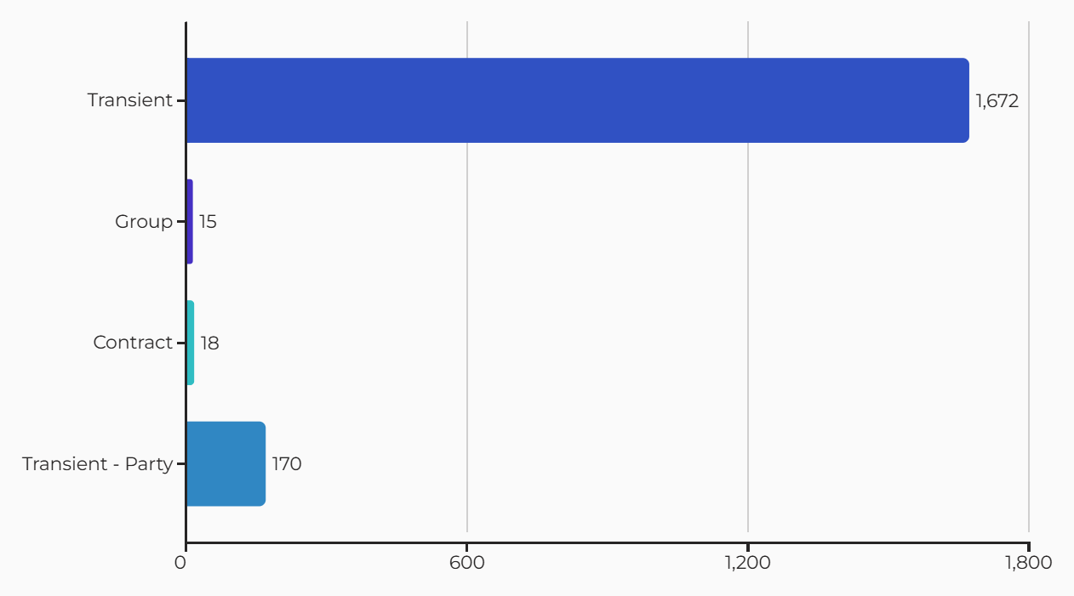
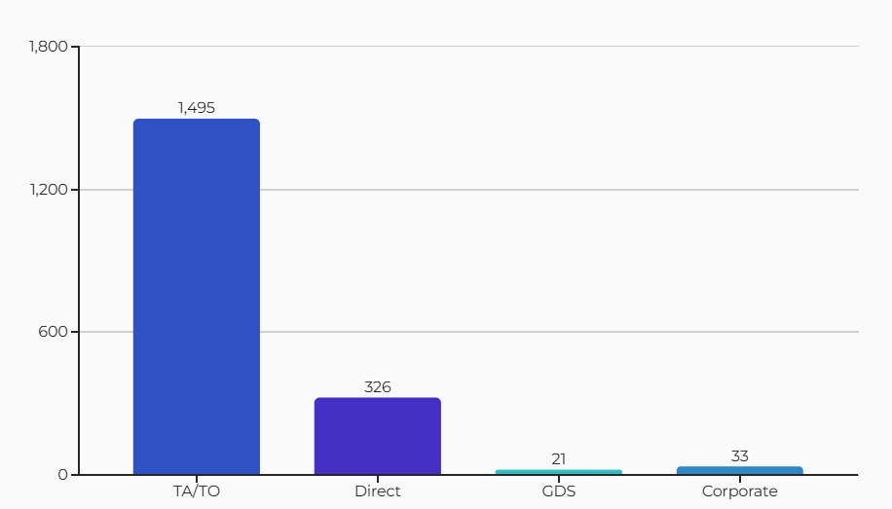



CUSTOMER SEGMENTATION ANALYSIS
2
3
Transient: 86% of total customers.
TA/TO channel: 78% of all bookings.
Group, Contract, GDS, and Corporate: less than 10%

Slide 6
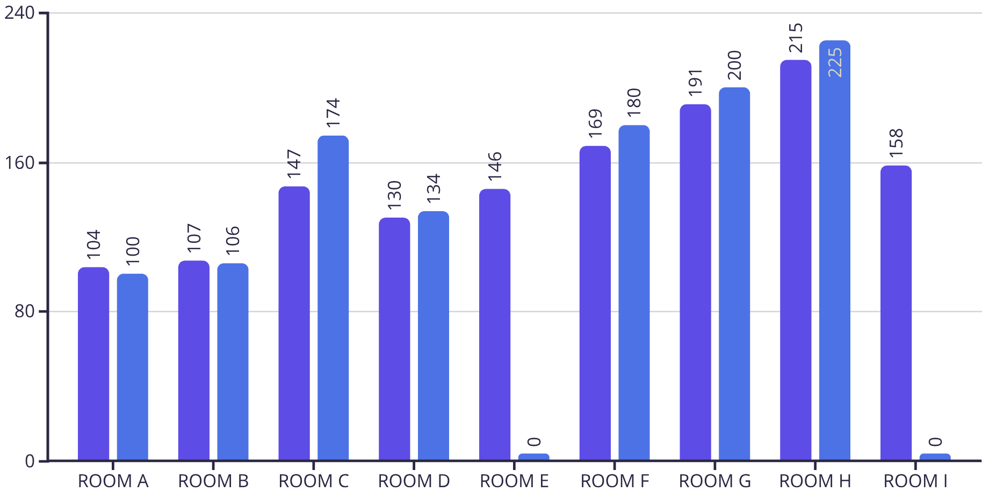
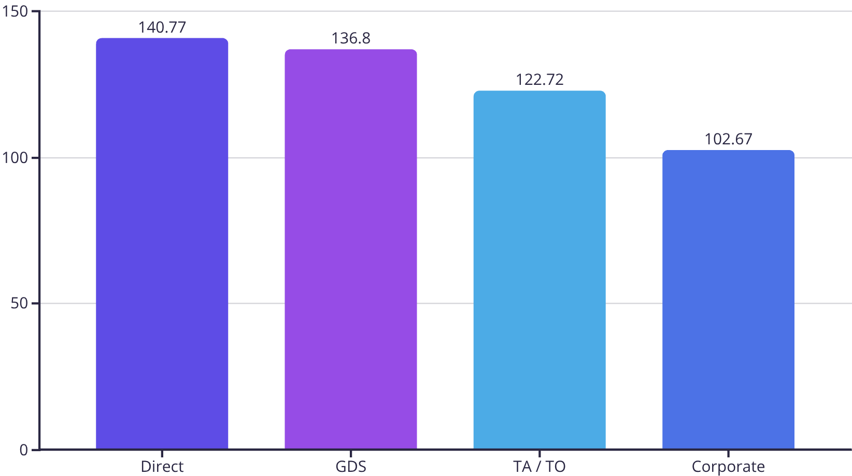
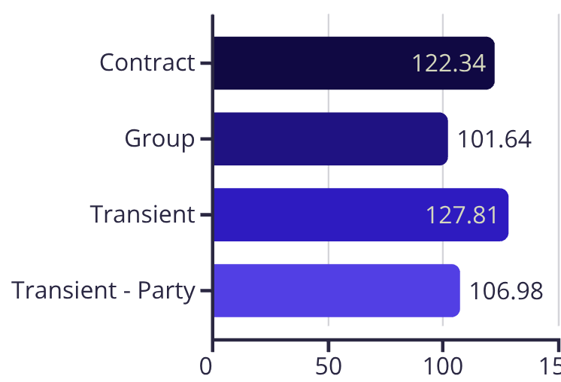



REVENUE MANAGEMENT ANALYSIS
Avg ADR by Distribution Channel
Avg ADR Assigned Rooms
Avg ADR Reserved Rooms
Room(H): Highest ADR at 225, boosting total revenue
Direct & GDS channels: Best AVG ADR (140.77 and 136.8)
Transient customers: Lead in average ADR (127.81)
Avg ADR BY Customer Type

Slide 7
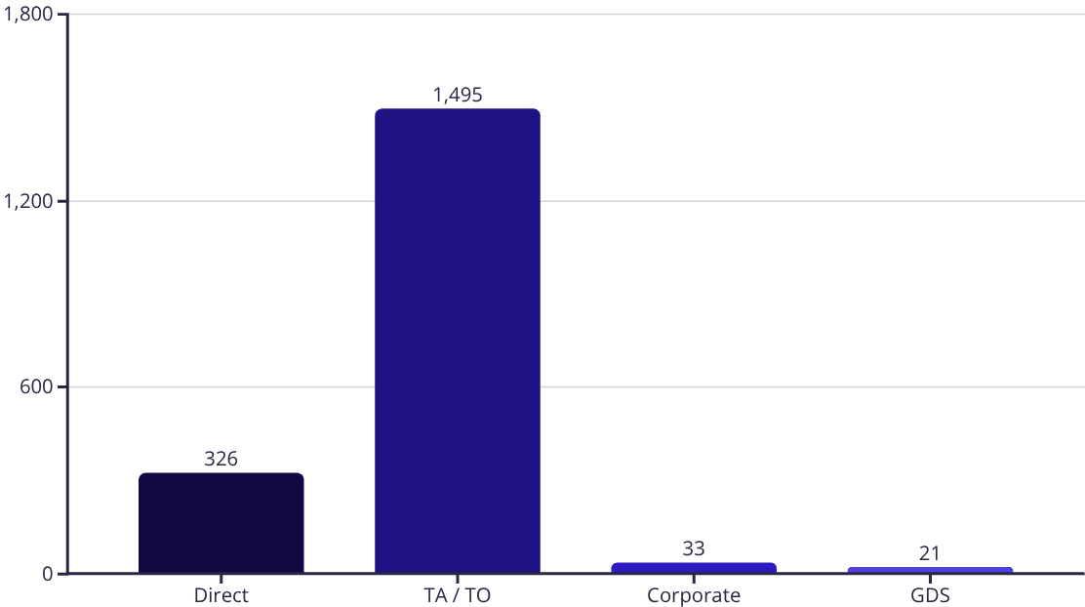
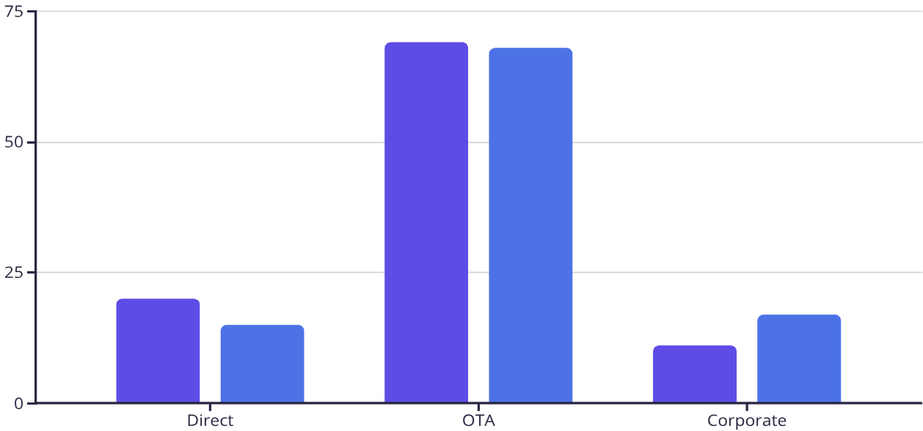
OPERATIONAL EFFICIENCY ANALYSIS
OTA/TA gives 70% of bookings.
OTA bookings reach 1,495 (highest).
Corporate channel cancellations low at 18%
OTA/TA cancellations high at 68%.
OTA dependence risk: 70% of bookings
No. of Bookings by Distribution Channel
2
Bookings (%)
Cancellations (%)
Bookings and Cancellations by Channel

Slide 8
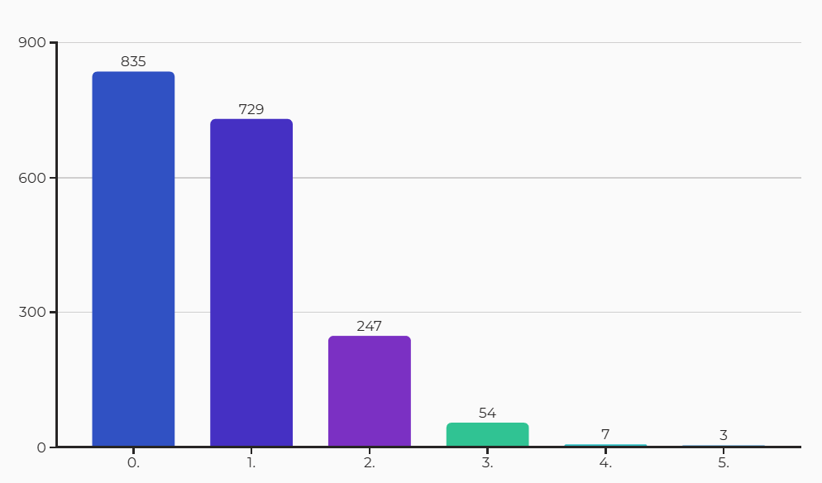
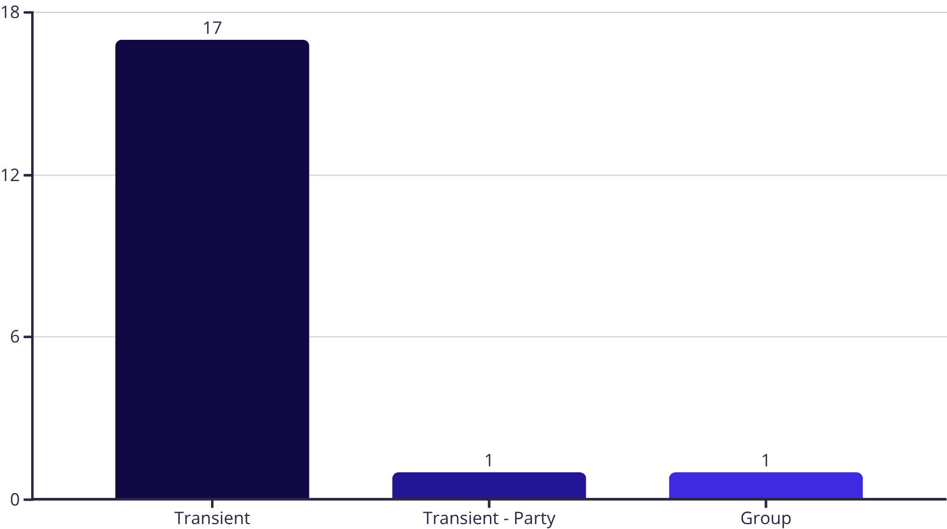

LOYALTY AND REPEAT BUSINESS
Customer type by Repeated Guests
Bookings by Special Requests
89% of repeat guests are transients
46% of bookings have just one request
Very few Repeated guests in Group and Transient-Party segments
53% of bookings have zero special requests

Slide 9
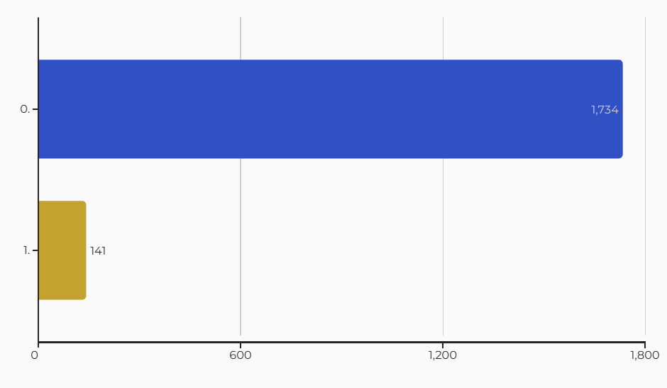
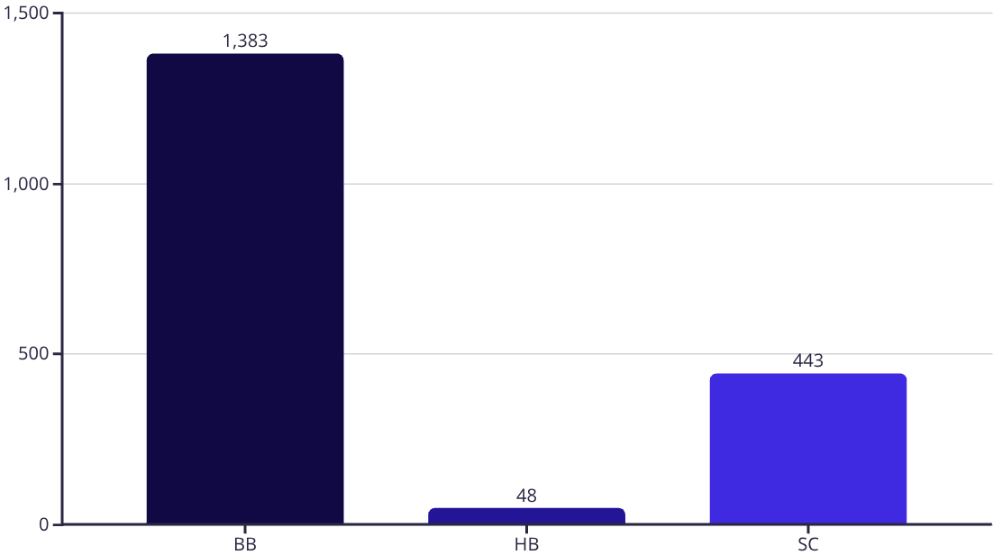
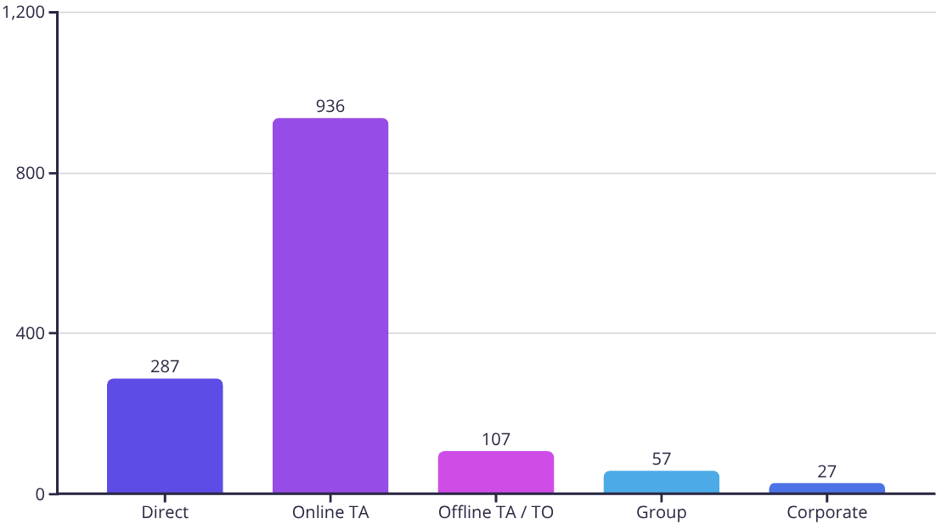
MARKET SEGMENTATION & CUSTOMER SATISFACTION
Car Parking Requirements
No. of Bookings by Meal Type
Top Meal: 73% of bookings are Bed & Breakfast (BB)
71% of bookings from Online TA; Direct is 20%, others 9%.
93% of guests do not need parking
Half Board and group/corporate segments have very low uptake
Bookings by Market Segment

Slide 10

OVERALL SUMMARY
2097
25%
66%
Total Bookings
Total Cancellations
Top Meal Type (BB)
The number of Bookings recorded.
524 Cancellation out of 2097 Bookings.
Breakfast Board (1383) is most popular meal
13%
926
$225
Top Month (August)
Most Booked Room Type(A)
Avg ADR Room Type(H)
266 Bookings in August
Most Frequently booked Room tyoe Avg ADR of 104
Assigned and Reserved Room type Together
The hotel excels in digital bookings and operational efficiency, positioning itself strongly for continued growth.
Despite a 25% cancellation rate, strong booking volumes ensure consistent occupancy and revenue flow.
Most cancellations come from TA/TO channels and transient customers during Peak Months

Slide 11
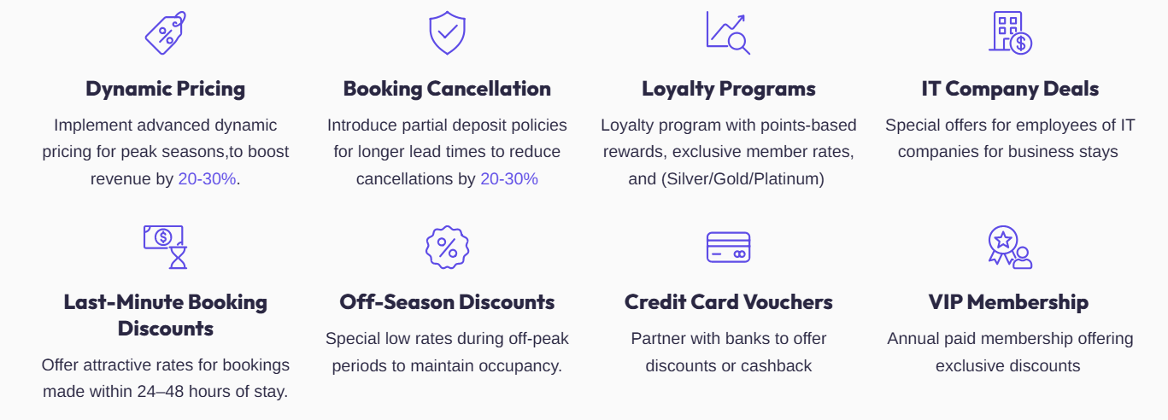
RECOMMENDATIONS

